Slide 1



Market Knowledge
Project Planning Approach
(MK PMO)
August 30, 2005
Confidential Property and Information

Slide 2
Agenda
Goals;
Team structure;
PQC Model;
Processes;
Methodology
PMO “Wares”;
Operating Rhythm;
Resource Matrix;
Metrics;
Acxiom Managed areas;

Slide 3
Goals
A true “product” project view of the plans;
Leverage “agile” across the program;
Streamline metrics (focus on exceptions/actions);
Laser refinement of metrics (e.g. earned value (EVA), effort to complete (ETC), resource pool, etc.);
Simplify reporting (metrics will be posted in Share Point via a cockpit like view);
Ensure long-term iteration view via release view;
Enforces follow of PQC toll gates;
Provides ongoing templates that ensure focus (scope);

Slide 4

MKG PQC
Initiation
Analyze
Design
Build
Test
QA
Prod.
Sunset
QC1
QC2
QC3
QC4
QC5
QC6
QC7
QC8
Initiation
Business Req.?
Definition;
In/Out scope;
H-L Deliverables?;
Planning Team;
Release Plan
Delivery
QC1
Approved?
R
G
(Bus. Champion)
Analyze
Work Breakdown Structure (WBS)
In/Out scope commitment;
Cost Ben. Anal. (CBA) -CFO Aprvl
Execution Team (commitment);
Iteration Plan (re-factoring incl.);
QC2
Approved?
R
G
(Bus. Unit Leader)
Design
Design review (prior to feat. design);
Architectural commitment;
Critical path;
Detailed project plan;
Risk assessment (FMEA);
Test Plan;
QC3
Approved?
R
G
(CTO)
Build
SDLC Framework;
Metric model;
Ops Model;
Development Model
Risk Mitigation;
Test plan;
QC4
Approved?
R
G
(PMO Leader)
Test
Test plan (ongoing);
Communication plan;
Ops model update/communication;
Load test;
QC5
Approved?
R
G
(QE Leader)
QA
Documentation clean-up;
Stand. Oper. Procedures (SOPs);
Change control;
Deployment model;
UAT;
QC6
Approved?
R
G
(QE / Bus. Leader)
Production
Deploy;
Sunset review plan;
Control measures;
Production re-assessment;
QC7
Approved?
R
G
(Ops Leader)
QC
Quality Control-point
*Note: Dark Blue QC’s are required for all iteration plans and RED highlighted are required for development plans!

Slide 5
PMO Meetings
Sts | Name | Description | Day/Time | Frequency
 | PMO Meeting | Meeting to address PMO related topics on work product, etc. | Monday 1 PM | Weekly
 | PQC Meeting | Meeting to allow project WC reviews and approvals | Tuesday 10 AM | Weekly
 | PMO Project Walks | Randomly selected project MK related project plan reviews | Friday 10 AM | Weekly
 | Project Team Status | Regular project team meetings to address status, issues, risks, etc. | various | Daily / Weekly
 | Project “Late” Walks | Reviews by each plan the late work products with corrective action plans daily. | Friday 1:30 PM | Weekly

Slide 6
*Based on deadline, scope and budget!!
Program Project Metrics
Planned
Critical
Warning
On Target
Sts | Metric | Description | Frequency | When
 | Product | Roadmap product deliverables. | Weekly | Monday COB
 | Product Conceptualization | Identifying timings and stages for concepts. | Weekly | Monday COB
 | Product Commercialization (new) | Progress of commercialization of a products delivery to the marketplace | Weekly | Monday COB
 | Product Iteration Plan | Iterations per product showing delivery dates and status which is in turn rolled up to the product plan. | Weekly | Monday COB
 | Product Development Plan | Per development plan showing delivery and status to each plan which is in turn rolled up to the iteration plan. | Weekly | Monday COB
 | Use Case Delivery | Authoring, review, defect and progress to plan related to product iteration. | Weekly | Monday COB
 | Project Planning | Track the creation of a project plan. | Weekly | Friday BOB
 | Project Plan Defects | Refinement of a project plan to ensure completeness and proper plan management for enterprise rollups. | Weekly | Tuesday BOB
 | On-boarding | Show the acquisition to plan for resources. | Weekly | Friday COB
 | Tool Training (new) | Tool training progress for all resources | Weekly | Friday COB
 | Performance | Performance of grid, data loads, etc. | Weekly | Monday COB
* COB – Close of business (5PM CST); BOB – Beginning of business (8 AM CST)

Slide 7
Prod. Mgr.
Eng.
Proj. Mgr.
Release Planning Process
Effort Estimate
&
Skillset
Concept
Approval
PQC
Tollgates
Funded
Voices | Concept Initiation | Business Case | Features | KQC’s | QFD (Correlation) | Iteration Plan | Build / Test | GA
Customer Employee Chairman Market Industry Business | Vision | Objectives Commitment | (Grouped) | 30% Innovation 30% Quality 15% Oper. Efficiency 15% Revenue ($$) 10% Globalization | 6 – Strong 3 – Moderate 1 – Light 0 – None | Prod. Mgr. & Engineering Trade-offs | Design
 | Value Proposition | Competition (cannibalization) | Functional Definition |  | Release Plan | Final Iteration Plan | Dev.
 |  | Operational Burden (margin) | Priority |  | Business Iteration Plan | Scope Locked In Current Iteration | Builds
 |  | Pricing Model |  |  |  | Use Case Dev. | Test
 |  | Pricing Continuum |  |  |  | Development (Project) Plan
 |  | Pipeline (renew %) |  |  |  | *Iterates
 |  | Annual Rev $ Projection
Stage 1 Complete
Stage 2 Complete
Stage 3 Complete
Stage
1
2
3
Concept
Bus. Case
Project

Slide 8
Prod. Mgr.
Eng.
Proj. Mgr.
Program Project Planning Flow
PQC Process
Link
Roadmap | Product Release Plan | Product Requirements | Iteration Plans | Development Plans
{Input from Product Mgmt.} | By Specific Product | Functional | Iteration Preparation (use cases, etc.) | Build Plan
Product Centric | H-L Business Outcomes | Non-functional | Iteration Commit Feature/Dates | Specific Work Tasks
Inclusive of Conceptualization | Team Commitment (SME’s) | Team Commitment (overall) | Iteration Test Plan | Wire Frames (UED)
 | Linkage: Product/Release # | Beta Needs (pilot, if any) | Budget | Functions
 |  | Client Migration Strategy | Linkage: Product/Release #/Iteration/Feature | Specific Resource Assignment
 |  | Commercialization |  | Resource Allocation (per functional work task)
 |  | Linkage: Product/Release # |  | Actual time posted
 |  |  |  | % Complete and ETC tracked
 |  |  |  | Move into Coding
 |  |  |  | Metrics Tracked
 |  |  |  | Development
 |  |  |  | Unit Testing
 |  |  |  | Linkage: Product/Release #/Iteration/Feature/Function
PQC
Tollgate 1
PQC
Tollgate 2
PQC
Tollgate 3

Slide 9
Use Case (UC) Process
Iteration Plan | Authoring (A) | Review (B) | Defects (C) | Analysis & Design (D)
{Input from Product Mgmt.} | Lead Author | UC’s reviewed as available (iterative) | Lead Author Resolves | Questions? Sent to Lead Author
Features | Team Assembled (Authors & Reviewers) | Defects sent for resolution (C) | Sent back to Authoring for correction (A) | Functions Defined (iterative)
Functional Definition (Req.) | Authoring Plan |  |  | Estimates per function
Priority | Each UC sent forward to Review (B) when ready |  |  | Work tasks defined
 |  |  |  | Wire Frames (UED)
 |  |  |  | Move into Coding

Slide 10
Methodology (Iterative -Agile)
Initiation
Analyze
QC1
QC2
Design
QC3
Build
QC4
Test
QC5
QA
Prod.
Sunset
QC6
QC7

Slide 11
PMO “Wares”
 | Primary Tool | Secondary Tool
WBS | MS/Project | Functional Matrix
Critical Path | MS/Project | MS/Excel
Budget | MS/Excel
Plan | MS/Project Server
Metrics | MS/Project | MS/Power Point
Integration Plan | MS/Project Server
FMEA | FMEA Template
Excellent
Very good
Good
Fair
Poor

Slide 12
Fast Facts
Project Plans
 | Actual | Average
Plans | 20
Tasks | 6,405 | 320
Effort | 130,425 hr | 6,521 hr
Resources | 429 (across all projects) | 21.5
Schedule Management
IRI | 17
Acxiom | 3
MK PMO Resources
 | Role | Current | Planned | Attrition | Managed/ Unmanaged | Acquired
IRI | Proj. Mgr. | 5 | 8 | 2 | 1/1 | Sep ‘04
Acxiom | Proj. Mgr. | 3 | 1 |  |  | Jun ‘05
Acxiom | Metrics | 1 |  |  |  | Jul ‘05
Acxiom | Proj. Svr. Resource | 1 |  |  |  | Jul ‘05
Acxiom | PMO | 2 |  | 1 | 0/1 | Apr ’05 / Jul ‘05

Slide 13
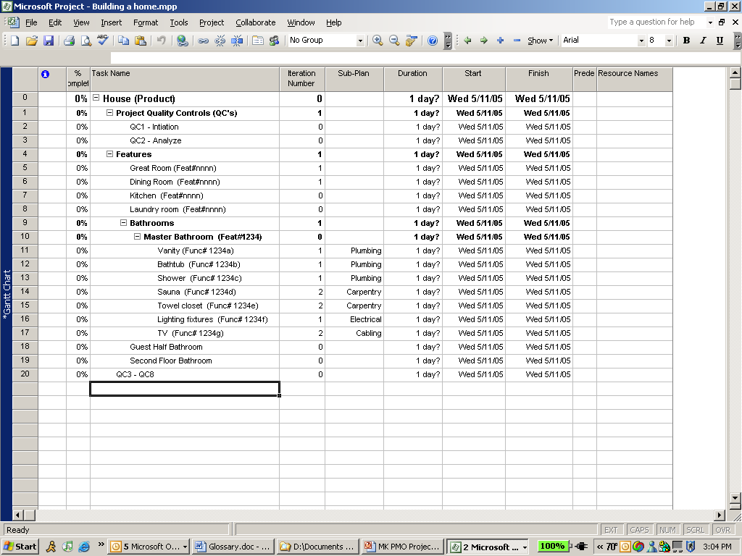
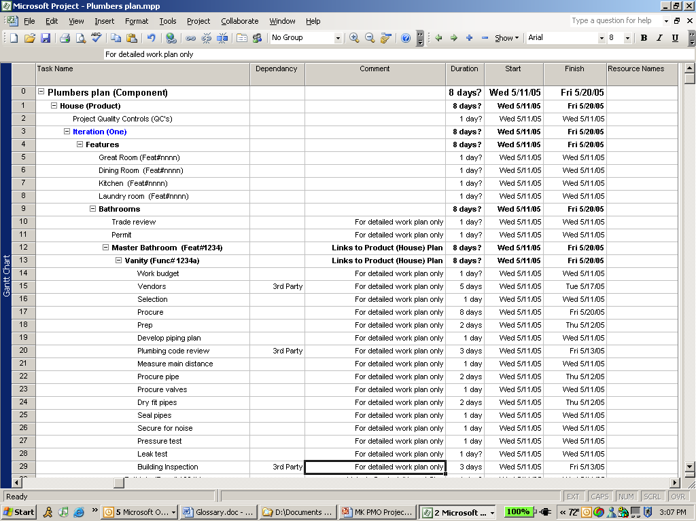
Approach
Product Plan
Development Plans
Product Plan:
Metrics would be managed at this level (supported by dependencies and specifics of development plans);
Overall Project Lead;
Individual Project Managers responsible for the development plans;
Overall project metrics would be tracked encapsulating all development plans;
Agile approach with iterations;
Tracking Link: Iteration/Feature/Function
Development Plan:
Metrics would be managed at this level to substantiate the Product Plan;
Detail work tasks;
Detailed resource matrix;
Time tracking and entry back track per work team members;
Agile approach with iterations;
Dependencies tracked throughout each plan;
Tracking Link: Iteration/Feature/Function

Slide 14
MK Operating Rhythm
 | Dec ‘04 | Jan ’05 | Feb ’05 | Mar ‘05 | Apr ‘05 | May ’05 | Jun ’05 | Jul ‘05 | Aug ’05 | Sep ’05 | Oct ’05 | Nov ‘05 | Dec ’05
WBS
Critical Path
Budget Planning
Plan
Metrics
Integration Planning
FMEA
Time Entry (Project)
Cultural Accountability
Decisiveness
Excellent
Very good
Good
Fair
Poor

Slide 15
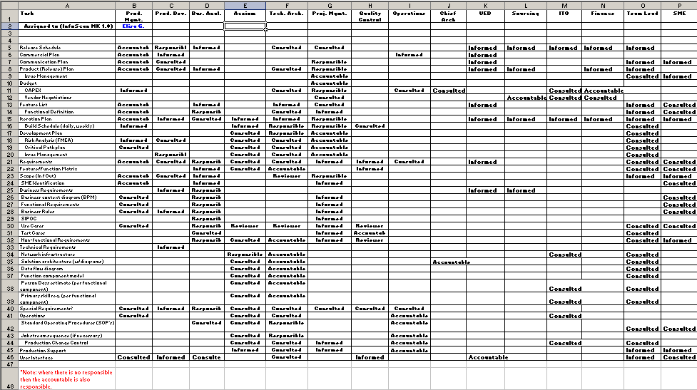
RACI Matrix
For each project the PM would fill-out the people resources covering the roles necessary. This clearly illustrates to each person what they are tasked with owning and/or participating in throughout the project life cycle.

Slide 16
MK Plan Metrics
 | PM | Apr ‘05 | May ’05 | Jun ’05 | Jul ‘05 | Aug ’05 | Comments
ISMK V1R0 USA | Rachel |  |  |  |  |  | Is properly tagged at milestone level (shows roadmap).
Iteration One | Rachel |  |  |  |  |  | Iteration nearly complete but is lacking current status of iteration level tasks. Will be corrected in I2 plan.
Iteration Two | Rachel |  |  |  |  |  | In progress of updating plan level tasks and complete by end of July.
DMS (Venue) | Sharon |  |  |  |  |  | Traction with vision holding back details for plan
DMS (Product) | Sharon |  |  |  |  |  | Traction with vision holding back details for plan
MMS | Sharon |  |  |  |  |  | Update rhythm established with focused deliverables; inconsistent remaining work values
DIV | Sharon |  |  |  |  |  | Update rhythm established with focused deliverables; inconsistent remaining work value
JETS | Sharon |  |  |  |  |  | Update rhythm established with focused deliverables; inconsistent remaining work value
OMS | Vivek |  |  |  |  |  | Update rhythm becoming established; traction with agreed scope caused delays for detailed planning
DCS | John P. |  |  |  |  |  | Traction with agreed scope caused delays for detailed planning; update rhythm needs to be established
BRMS | Martin |  |  |  |  |  | Update rhythm established with focused deliverables
DMC | Manish |  |  |  |  |  | Update rhythm established with focused deliverables
FDW | Mike S.
Excellent
Very good
Good
Fair
Poor

Slide 17
MK Roadmap
*Based on deadline, scope and budget!!
Today
Planned
Critical
Warning
On Target
 | Owner | Acxiom? | May | Jun | Jul | Aug | Sep | Oct | Nov | Dec | Jan ‘06 | Feb06 | Mar ‘06 | 2Q 06 | 3Q06 | 4Q06
Products
InfoScan MK Release V1R0 (USA - GA) | Terese H. | Yes |  |  |  |  |  |  |  |  |  |  | 4/1
Daily Data | Jeanne L. | Yes |  |  |  |  |  | TBD
Plus Suite | Jeff O. |  |  |  |  |  |  |  | 11/30
RPM | Jeff O. |  |  |  |  | 9/5
AS | Jeff O. |  |  |  |  | 9/5
New Country Expansion | Marco C. |  |  |  |  |  |  |  |  |  | 2/1
InfoScan MK Release V2R0 (Global) | Marco C.
Mainframe Retirement (MFR) | Tom P. | Yes |  |  |  |  |  |  | 11/1 |  | 1/31
Process Re-engineering | John M. |  |  |  |  |  |  |  |  |  |  |  | 3/31
Data Integrity | TBD |  |  |  |  |  |  |  |  |  |  | 2/28
Customer Migration | Terese H.
InfoView QS3 Replacement
Netegrity Pepsi SSO-SAML solution | Scott N. | Yes |  |  |  | 8/5 | 9/30

Slide 18
MK Product Release Planning
*Based on deadline, scope and budget!!
Today
Planned
Critical
Warning
On Target
 | Owner | Stage | Jun | Jul | Aug | Sep | Oct | Nov | Dec | Jan ‘06 | Feb’06 | Mar ‘06 | 2Q 06 | 3Q06 | 4Q06 | 1Q07
Product
InfoScan MK Release V1R0 (USA) | Elisa G. | 3 |  |  |  |  |  |  |  |  |  | 4/3
New Country Expansion (NCE) | Marco C. | 3 |  |  |  |  |  |  |  |  | 2/1
Builders MK | Paul W. | 3 |  |  |  |  |  |  | 12/1
Consumer MK | Paul W. | 2
InfoScan MK V2R0 (Global) | Marco C. | 2 |  |  |  | 9/15
New Solutions
Drivers Advisor (Coefficient Factory) | TBD | 1 |  | 7/15
Same store sales reporting | Deb P. | 1 |  | 7/30
Store Clustering | Stuart R. | 1 |  | 7/15
Holiday Tracker (Daily) | Marianne | 1 |  | 7/15
Trendspotter | Stuart R. | 1 |  | 7/30
Stage
1
2
3
Concept
Bus. Case
Project

Slide 19
Product Iterations
*Based on deadline, scope and budget!!
Today
Planned
Critical
Warning
On Target
 | Owner | Acxiom? | May | Jun | Jul | Aug | Sep | Oct | Nov | Dec | Jan ‘06 | Feb’06 | Mar ‘06 | 2Q 06 | 3Q06 | 4Q06
InfoScan MK Release V1R0 | Terese H.
Market Positioning/Pricing | Terese H.
Iteration One | Rachel T. | Yes |  |  | 7/31 | 8/5
Iteration Two | Rachel T. | Yes |  | Req | Req |  | 10/1
Iteration Three | Rachel T. | Yes |  |  |  | Req | Req |  | 12/1
Iteration Four | Rachel T. | Yes |  |  |  |  |  | Req | Req |  | 2/1
Iteration Five (GA) | Rachel T. | Yes |  |  |  |  |  |  |  |  |  |  | 4/1
Commercialization | Elisa G.
Daily Data | Jeanne L.
V3R0 | Alex M. | Yes |  | 6/30
V3R1 | Alex M. | Yes |  |  |  |  |  | TBD
Plus Suite | Jeff O.
V2R0 – Ext. Pilot | Alex M. |  |  |  | 7/29
V2R1 | Alex M. |  |  |  | 7/29
V2R2 | Alex M. |  |  |  |  |  |  |  | 11/30
RPM
Magellan | Alex M. |  |  |  |  |  | 9/5
AS
Mustang | Alex M. |  |  |  |  |  | 9/5
New Country Expansion | Helen S. |  |  |  |  |  |  |  |  |  | 2/1

Slide 20
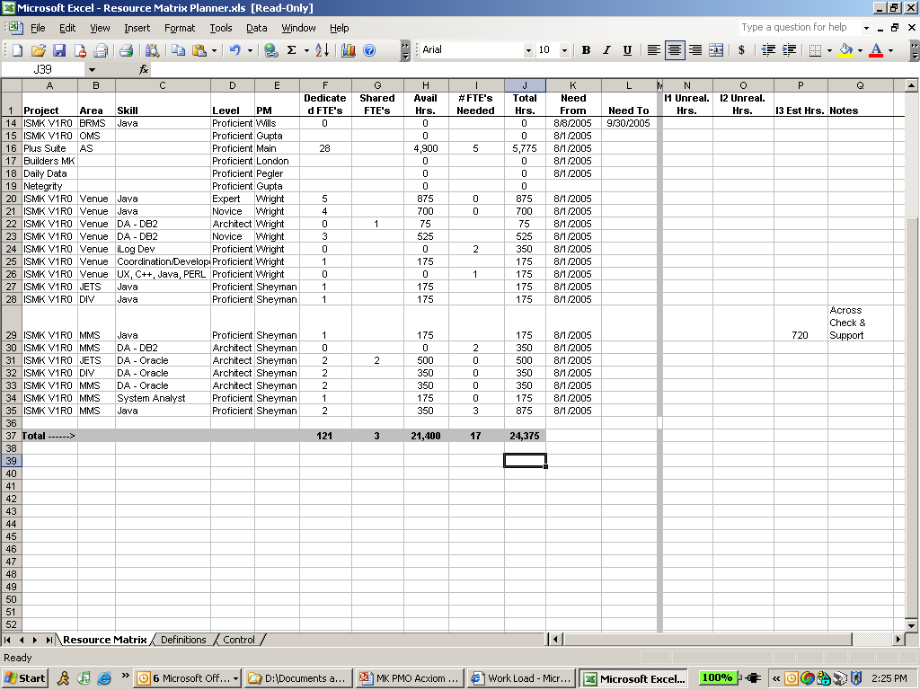
Resource Planner

Slide 21





MK Factory Framework
Core Factory
Data
Marts
OLAP
Visualization
End Users
Selector
OMS
DMS
MMS
RPM
AS
BRMS
AS
DMC
BPM
DIV
JETS
…
Other..
Office
Viewer
Evolution…
Retailers
FDW
DCS
DTM
Acxiom Grid
Acxiom Managed
IRI Managed

Slide 22
Appendix

Slide 23
(House Plan) Example
Feature scope would be locked down and require a project change control approval for alteration of features, budget or date.
Dependencies for each feature/function for the current iteration would relate to the sub-plan.
Each function has one owning sub-plan.

Slide 24
(Plumbing Plan) Example
Specific work tasks to develop the function would only be managed in the detail plumbing plan.
Feature/function would create linkage to the House Plan
The detail plumbing plan team would be empowered to swap feature/functionality that is not core capability.

Slide 25
IRI Sample

Slide 26
Data Flows
1) POS – Weekly POS data from any outlet and any geography. (U.S., Europe, Grocery, Drug, Mass, etc.)
  Basic Units of Measure: sales and price per item, store, week
2) Panel – Household or consumer purchase and / or consumption data from any outlet or geography using any collection methodology. (ScanKey, Card, Specialty Panel, etc.)
  Basic Units of Measure: sales, price, promotion condition and time stamp for all items purchased per panelist per shopping occasion
3) Sale Flyer – Print-based promotion data for any outlet and any geography (Features, Prospectus, Coupons, U.S., Europe, Grocery, Drug, Mass, etc.)
  Basic Units of Measure: Type, class, discount and/or price and description per print ad per store per time period
4) Store - Store specific promotion data from any outlet and any geography (U.S., Europe, Grocery, Drug, Mass, etc.)
  Basic Units of Measure: Presence, type, class and description of promotion event per store per time period
5) Shelf Planning – Descriptive shelf information from any outlet and any geography. (Linear shelf space, shelf height or location, U.S., Europe, Grocery, Drug, Mass, etc.)
  Basic Units of Measure: Product and Shelf Dimensions, Product Counts per item per store per time period
6) European – Traditional sales audit data from any outlet and any geography. (U.S., Europe, Convenience, Small Grocers, Independent Breweries, etc.)
  Basic Units of Measure: Stocks (by location), deliveries, price, and presence/type of causal
7) Cigarette – POS plus traditional audit data (including that provided by 3rd parties such as Capstone) from any U.S. outlet. (Grocery, Drug, Tobacco Shops, etc.)
  Basic Units of Measure: sales, counts, price and causal per item, store week
8) TBD #1: Daily Data – POS data from any outlet and any geography. (U.S., Europe, Grocery, Drug, Mass, etc.)
  Basic Units of Measure: sales and price per item, store, week
9) TBD #2: Externally Supplied Movement Data – Vending, shipment and / or selected POS-like data from any outlet and any geography. (U.S., Europe, Grocery, Drug, Mass, etc.)
  Basic Units of Measure: quantity and price per item / SKU, location, time period
10) TBD #3

Slide 27
Glossary
Feature | A capability or characteristic of the system that directly fulfills a stakeholder need; represents functionality that is understandable to business users. Usually begins with “Ability to…”
System Requirement | A condition or capability to which a system must conform; either derived directly from user needs, or stated in a contract, standard, specification, or other document. Defines “what” the system should do rather than how the system does it. Functional and Non-Functional requirements are part of the system requirements.
Functional Requirement | Specifies a function that a system or system component must be able to perform - yields an observable result of value
Non-Function Requirement | Very important for system architecture: Usability - ease with which software can be learned and operated by the intended users Reliability - ability for the software to behave consistently in a user-acceptable manner Performance - measure of speed or efficiency of the running system Supportability - ability of the software to be easily modified to accommodate enhancements and repairs Operations -
Component | Architectural component that is needed to help efficiently realize features and functions. In essence becomes the build plan for functions. Typically a function is owned by a single component build plan (where more than one component is required to enable a function, a primary component will own the planning necessary to complete the function).
Release | Delivers a releasable to deployment product - GA. For larger projects and implementable segment
Iteration | Delivers a demonstrable portion of the application to a review process – makes product visible to a Customer Focus Group (a customer maybe internal or external). Consists of complete Functions…
Build | Constructs/builds a small, interim portion of the application – makes product visible to the Development Team

Slide 28
Approach to Risk ID
Typical project trajectory….
Pros
Easy to start;
???
Cons
Lots of uncertainty;
Huge risks late;
Constant hurdling;
Tough to get into rhythm;
Long time line ($$) to hurdle effort;
What if we can’t jump a hurdle late in the game?;
Very reactive;
Teams are tired at end with hurdles to overcome;
Start
Finish
Roadblock
Checkpoint
Runner

Slide 29
Approach to Risk ID
Preferred project trajectory….
Pros
Risks are mostly mitigated early;
Proactive;
Short time line ($$) to hurdle effort;
Team is less tired at completion of race;
Less stress;
More certainty;
Delivery confidence is higher early in the game;
Cons
More heavy lifting up front;
Start
Finish
Roadblock
Checkpoint
Runner
It’s all about track and field… a relay race.

